Slide 1
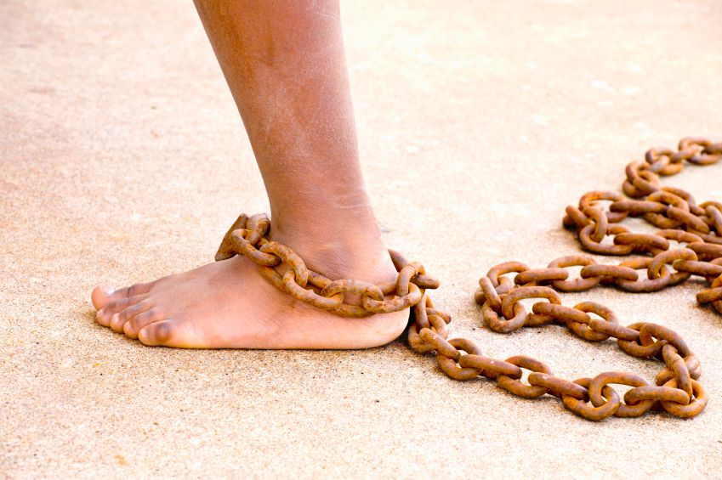
Be Forgiving
Philemon
Dr. Rick Griffith • Crossroads International Church Singapore
BibleStudyDownloads.org

Slide 2
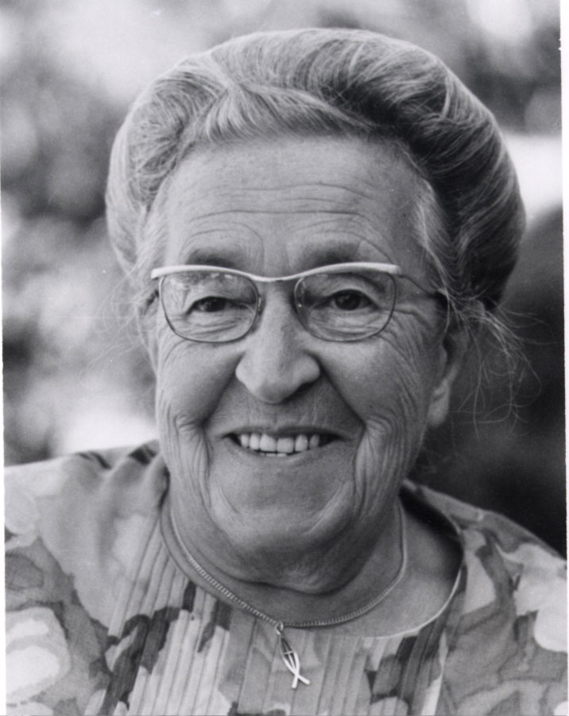
Corrie ten Boom
Notes:
Corrie ten Boom was a Dutch believer famous for her courageous efforts to help Jews escape the Nazi persecutions during World War II.

Slide 3
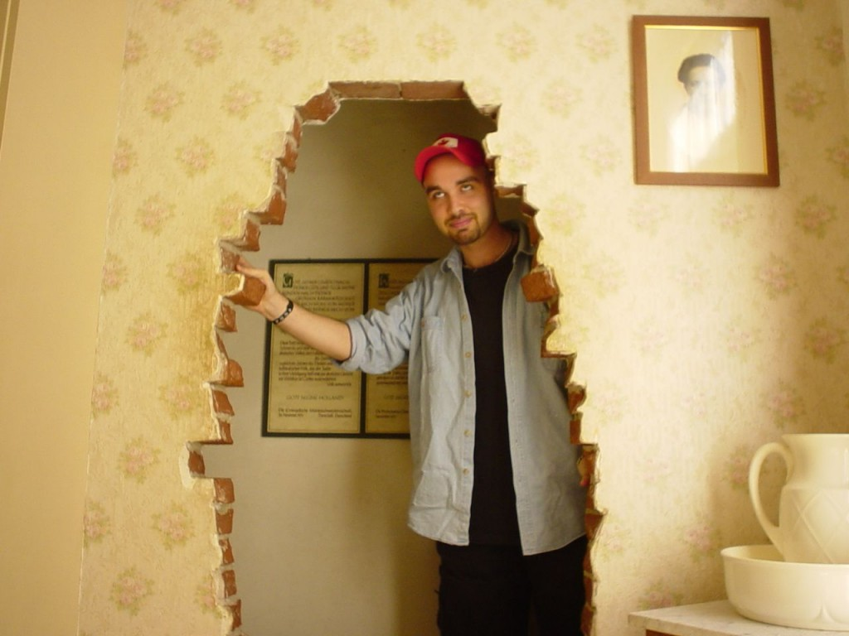
The Hiding Place
Notes:
She hid Jews in "The Hiding Place" in her home until they could be secretly sent out of the country.

Slide 4
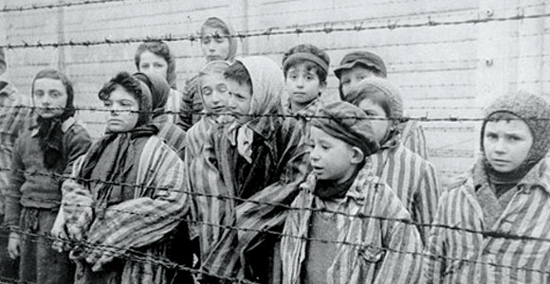
Corrie ten Boom
Notes:
For this she was sent to a concentration camp with her sister Betsy.

Slide 5
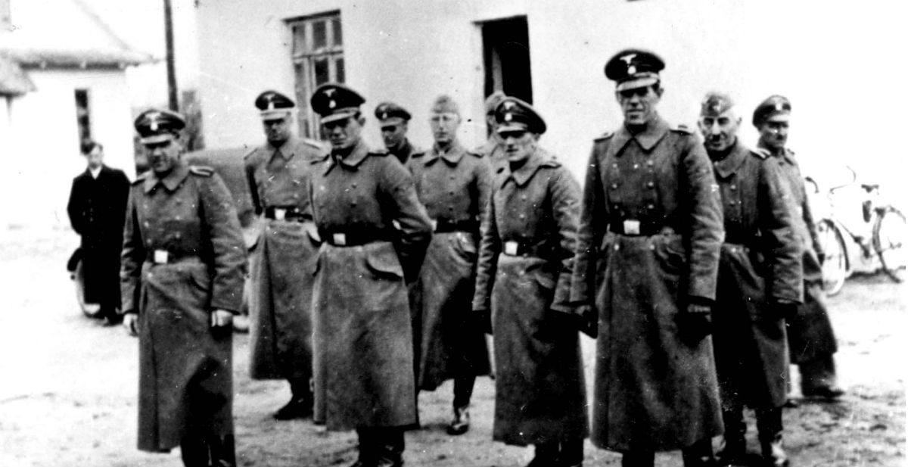
The Guards
The Jews
Notes:
After the war she traveled extensively sharing her experiences and recorded a very interesting account of one of these speaking engagements. At a city called Ravensbruck she spoke one night about forgiveness and afterwards a man came forward to talk to her.

Slide 6
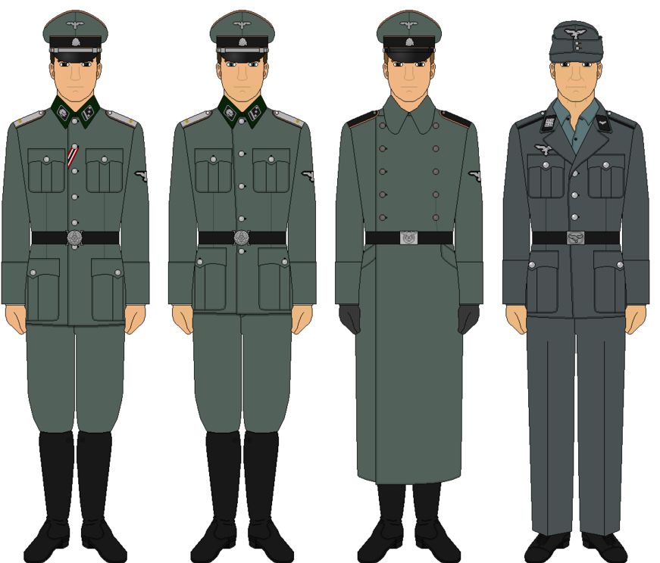
German Guards
Notes:
Corrie immediately recognized him as one of the guards in her concentration camp—one of the cruelest of all the guards! He was one responsible for the death of Corrie’s sister Betsy.

Slide 7
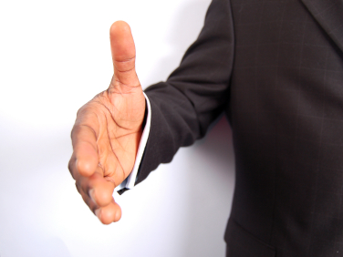
The outstretched hand
Notes:
“Nice sermon, Frauline," he said. "I want to experience that forgiveness God gives us, but it starts with asking you to forgive me. Will you forgive me?" He stuck out his hand for her to shake, but she froze (Tramp for the Lord, 55-56).

Slide 8

How to forgive those who offend us…
Notes:
Today we will see a very active step, that of how to forgive those who offend us. We'll look at a scriptural example of one who was strongly urged to forgive an offender.

Slide 9
Chapters in NT Books
Four "books" of the NT have but 1 chapter
متى
لوقا
اعمال
مرقس
يوحنا
رومية
1 كورنثوس
2 كورنثوس
غلاطية
افسس
فيلبي
كولوسي
1 تسالونيكي
2 تسالونيكي
1 تيموثاوس
2 تيموثاوس
تيطس
فليمون
عبرانيين
يعقوب
بطرس 1
بطرس 2
1 يوحنا
2 يوحنا
3 يوحنا
يهوذا
رؤيا
Notes:
We know that most of the NT books are longer books or letters. But in the next four weeks that I preach, we will study the four shortest ones as they are too often neglected.
______
Translators, please type over the Arabic and drag over the English above

Slide 10
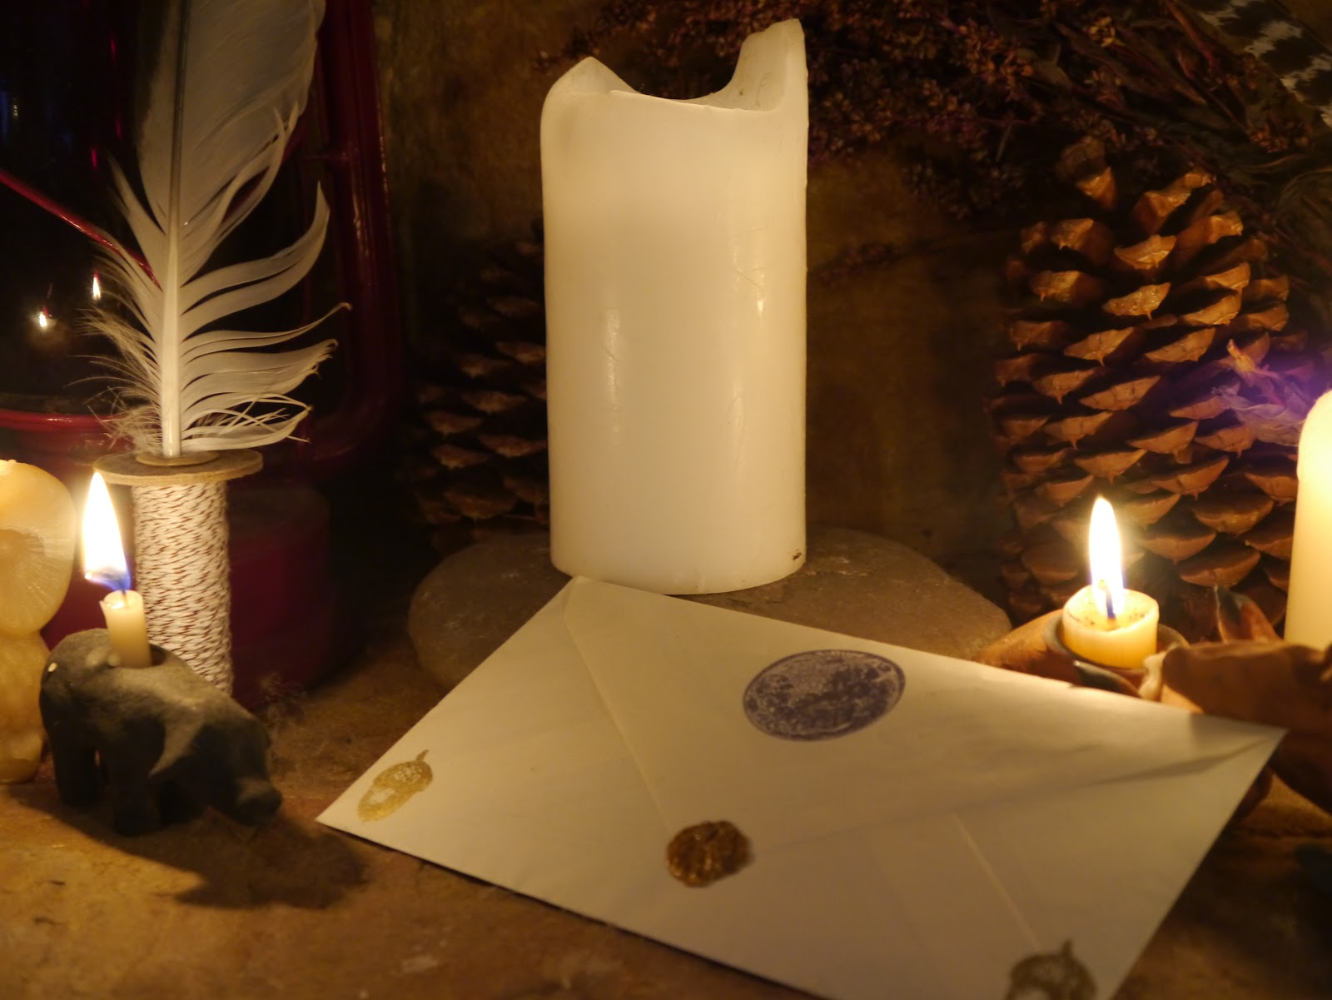
Verses in NT One-Chapter “Books”
Philemon
2 John
3 John
Jude
Notes:
These short letters are only 13 to 25 verses long, so we can cover one each week.

Slide 11
New Testament Emails
Philemon
2 John
3 John
Jude
Notes:
I call these "New Testament Emails" as they are about the length one puts in an email.

Slide 12
Postcard to Philemon
ROME
Παῦλος δέσµιος Χριστοῦ Ἰησοῦ καὶ Τιµόθεος ὁ ἀδελφὸς Φιλήµονι τῷ ἀγαπητῷ καὶ συνεργῷ ἡµῶν καὶ Ἀπφίᾳ τῇ ἀδελφῇ καὶ Ἀρχίππῳ τῷ
συστρατιωτῃ ἡµῶν καὶ τῇ κατ· οἶκόν σου
ἐκκλησίᾳ
χάρις ὑµῖν καὶ εἰρήνη ἀπὸ θεοῦ πατρὸς
ἡµῶν καὶ κυρίου Ἰησοῦ Χριστοῦ.
Postcard to Philemon
Notes:
Please turn in your Bible to the book of Philemon. It's just before Hebrews near the back of your New Testament. The book of Philemon is between Titus and Hebrews. It’s about the length of a postcard.

Slide 13
. Characteristics .
246
¹Paul, a prisoner of Christ Jesus, and Timothy our brother,
To Philemon our dear friend and fellow worker, ²to Apphia our sister, to Archippus our fellow soldier and to the church that meets in your home:
³Grace to you and peace from God our Father and the Lord Jesus Christ.
Thanksgiving and Prayer
⁴I always thank my God as I remember you in my prayers, ⁵because I hear about your faith in the Lord Jesus and your love for all the saints. ⁶I pray that you may be active in sharing your faith, so that you will have a full understanding of every good thing we have in Christ. ⁷Your love has given me great joy and encouragement, because you, brother, have refreshed the hearts of the saints.
Paul's Plea for Onesimus
⁸Therefore, although in Christ I could be bold and order you to do what you ought to do, ⁹yet I appeal to you on the basis of love. I then, as Paul–an old man and now also a prisoner of Christ Jesus– ¹⁰I appeal to you for my son Onesimus, who became my son while I was in chains. ¹¹Formerly he was useless to you, but now he has become useful both to you and to me.
¹²I am sending him–who is my very heart–back to you. ¹³I would have liked to keep him with me so that he could take your place in helping me while I am in chains for the gospel. ¹⁴But I did not want to do anything without your consent, so that any favor you do will be spontaneous and not forced. ¹⁵Perhaps the reason he was separated from you for a little while was that you might have him back for good– ¹⁶no longer as a slave, but better than a slave, as a dear brother. He is very dear to me but even dearer to you, both as a man and as a brother in the Lord.
¹⁷So if you consider me a partner, welcome him as you would welcome me. ¹⁸If he has done you any wrong or owes you anything, charge it to me. ¹⁹I, Paul, am writing this with my own hand. I will pay it back–not to mention that you owe me your very self. ²⁰I do wish, brother, that I may have some benefit from you in the Lord; refresh my heart in Christ. ²¹Confident of your obedience, I write to you, knowing that you will do even more than I ask.
²²And one thing more: Prepare a guest room for me, because I hope to be restored to you in answer to your prayers.
²³Epaphras, my fellow prisoner in Christ Jesus, sends you greetings. ²⁴And so do Mark, Aristarchus, Demas and Luke, my fellow workers.
²⁵The grace of the Lord Jesus Christ be with your spirit.
Shortest letter of Paul's epistles (25 verses)
Notes:
In fact, you can put the entire letter on a postcard! It is the shortest of Paul’s epistles in the NT.

Slide 14

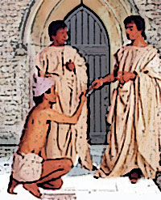
"This letter is from Paul, a prisoner for preaching the Good News about Christ Jesus, and from our brother Timothy. I am writing to Philemon, our beloved co-worker, ²and to our sister Apphia, and to our fellow soldier Archippus, and to the church that meets in your house” (vv. 1-2 NLT).
Notes:
Let’s read the entire letter to Philemon…

Slide 15
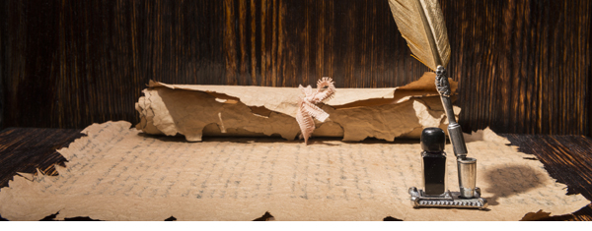
"May God our Father and the Lord Jesus Christ give you grace and peace"
(v. 3 NLT).

Slide 16

"I always thank my God when I pray for you, Philemon, ⁵because I keep hearing about your faith in the Lord Jesus and your love for all of God's people"
(vv. 4-5 NLT).

Slide 17

"And I am praying that you will put into action the generosity that comes from your faith as you understand and experience all the good things we have in Christ. ⁷Your love has given me much joy and comfort, my brother, for your kindness has often refreshed the hearts of God's people" (vv. 6-7 NLT).

Slide 18
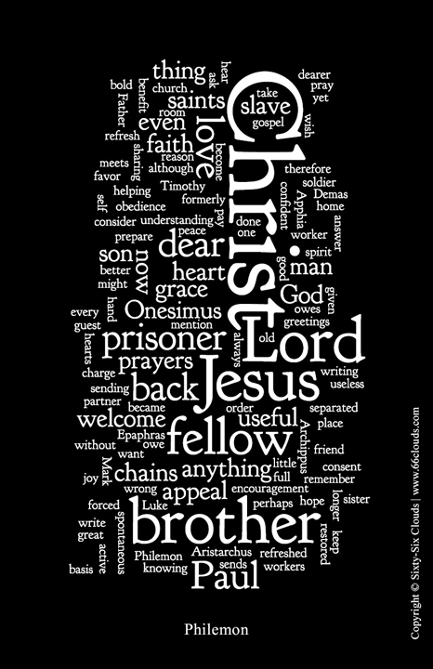
"That is why I am boldly asking a favor of you. I could demand it in the name of Christ because it is the right thing for you to do. ⁹But because of our love, I prefer simply to ask you. Consider this as a request from me—Paul, an old man and now also a prisoner for the sake of Christ Jesus"
(vv. 8-9 NLT).

Slide 19
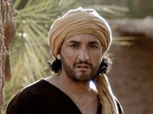
"I appeal to you to show kindness to my child, Onesimus. I became his father in the faith while here in prison. ¹¹Onesimus hasn't been of much use to you in the past, but now he is very useful to both of us.
¹²I am sending him back to you, and with him comes my own heart" (vv. 10-12 NLT).

Slide 20
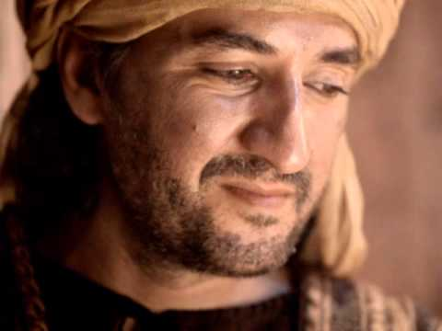
"I wanted to keep him here with me while I am in these chains for preaching the Good News, and he would have helped me on your behalf.
¹⁴But I didn't want to do anything without your consent. I wanted you to help because you were willing, not because you were forced” (vv. 13-14 NLT).

Slide 21
"It seems you lost Onesimus for a little while so that you could have him back forever. ¹⁶He is no longer like a slave to you. He is more than a slave, for he is a beloved brother, especially to me. Now he will mean much more to you, both as a man and as a brother in the Lord"
(vv. 15-16 NLT).

Slide 22
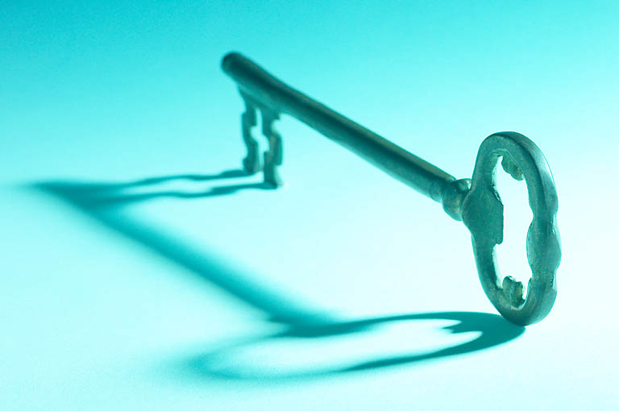
245
Verse 17
"So if you consider me a partner, welcome him as you would welcome me."

Slide 23
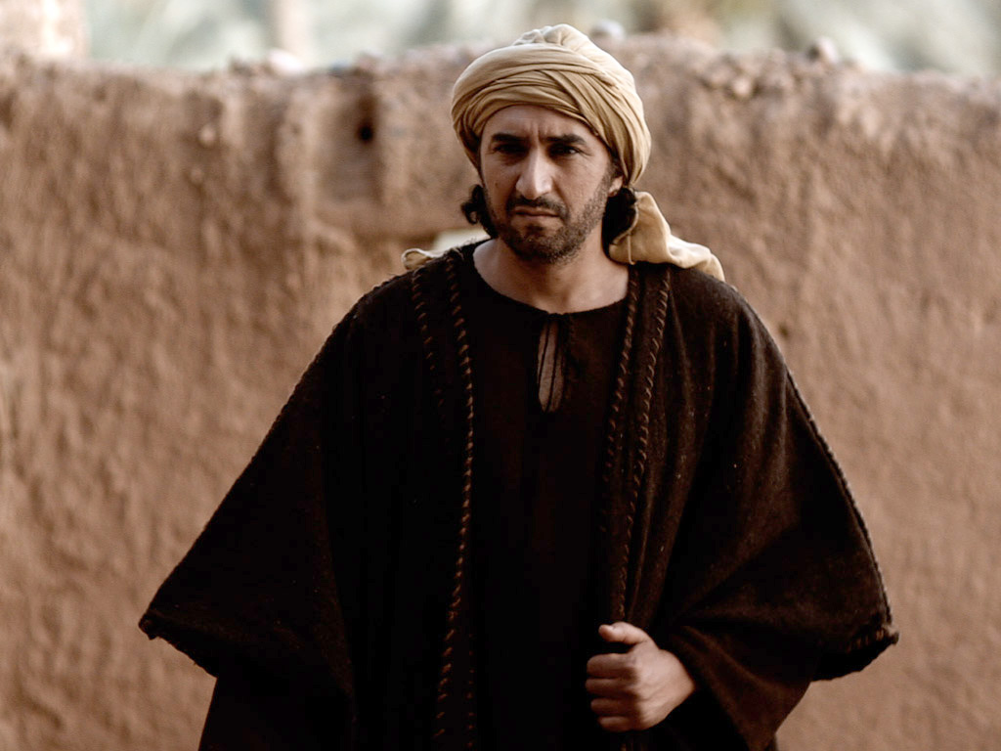
"If he has wronged you in any way or owes you anything, charge it to me"
(v. 18 NLT).

Slide 24
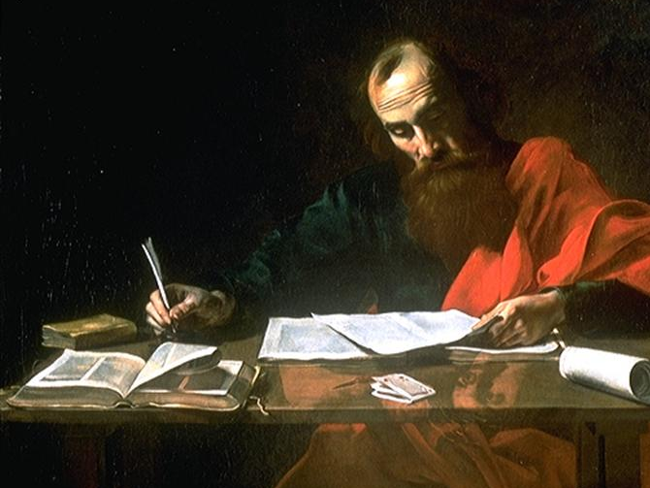
"I, Paul, write this with my own hand: I will repay it. And I won't mention that you owe me your very soul!” (v. 19 NLT).

Slide 25
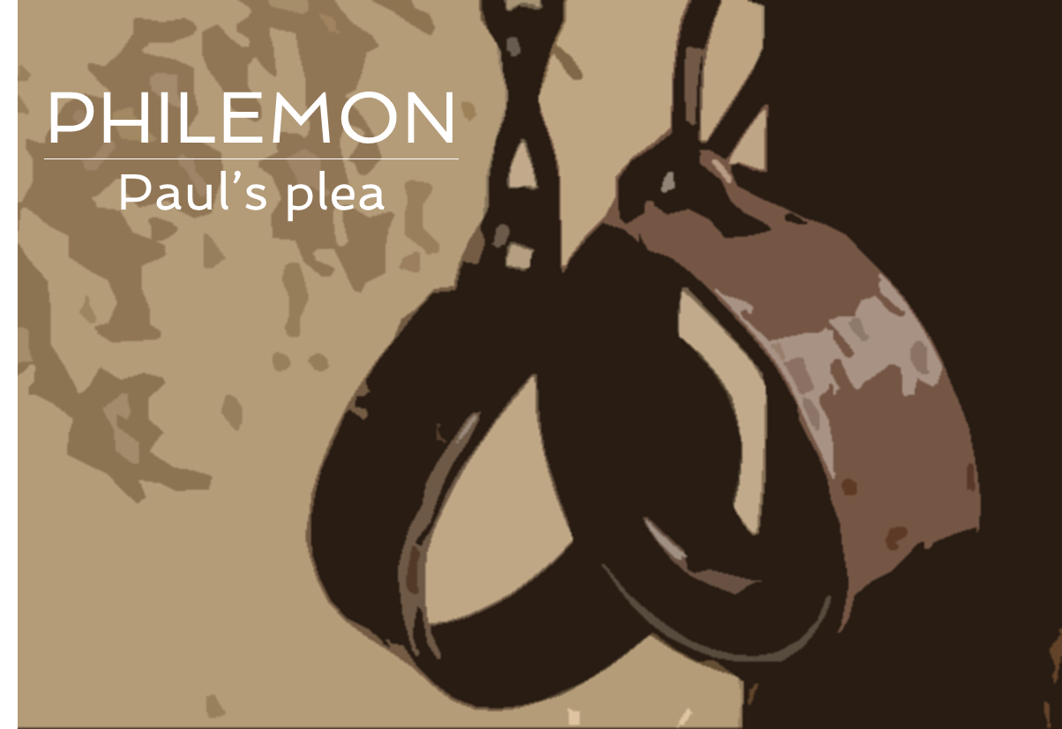
"Yes, my brother, please do me this favor for the Lord's sake. Give me this encouragement in Christ. ²¹I am confident as I write this letter that you will do what I ask and even more!"
(vv. 20-21 NLT).

Slide 26
"One more thing—please prepare a guest room for me, for I am hoping that God will answer your prayers and let me return to you soon" (v. 22 NLT).

Slide 27
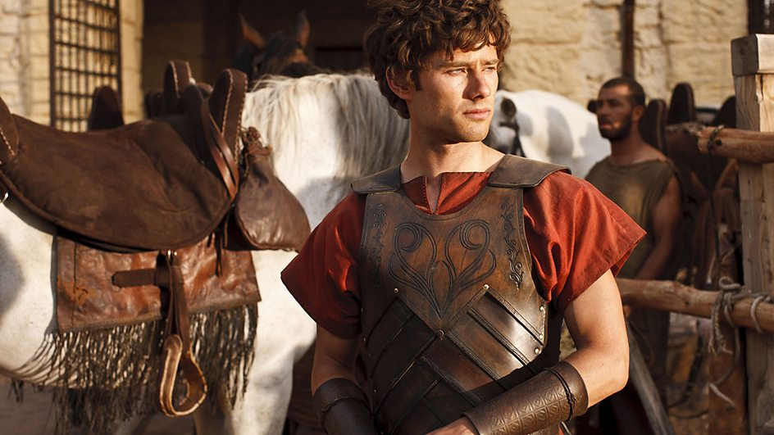
"Epaphras, my fellow prisoner in Christ Jesus, sends you his greetings. ²⁴So do Mark, Aristarchus, Demas, and Luke, my co-workers" (vv. 23-24 NLT).

Slide 28
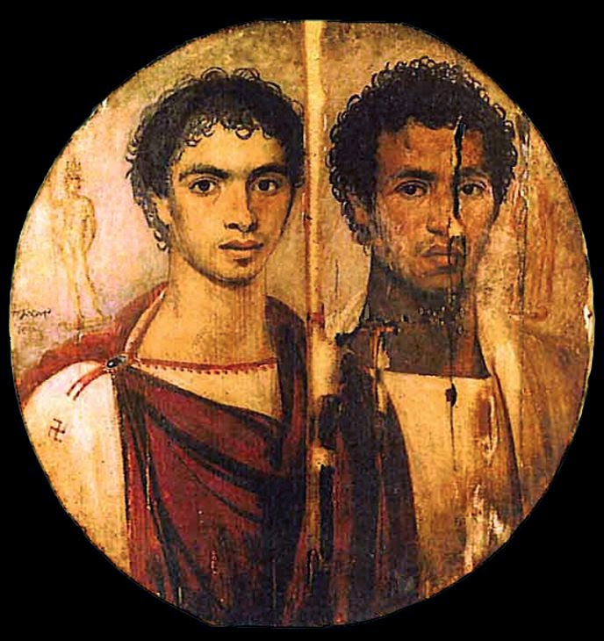
"May the grace of the Lord Jesus Christ be with your spirit" (v. 25 NLT).

Slide 29
How to forgive those who offend us…

Slide 30

I. Begin by seeing people in the best possible light (1-7).
Notes:
Paul began his appeal to Philemon on a very positive note (1-7).

Slide 31
"This letter is from Paul, a prisoner for preaching the Good News about Christ Jesus, and from our brother Timothy. I am writing to Philemon, our beloved co-worker, ²and to our sister Apphia, and to our fellow soldier Archippus, and to the church that meets in your house" (vv. 1-2 NLT).

Slide 32
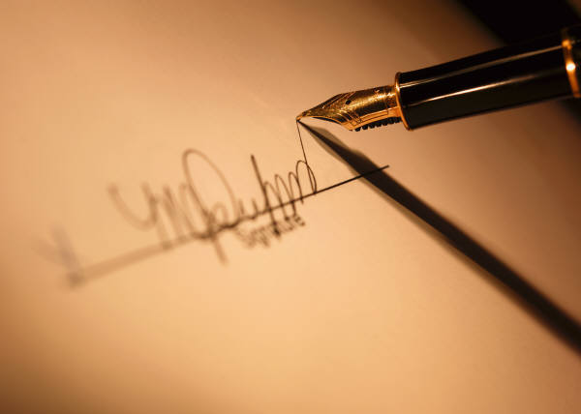
. Authorship .
246
Paul
Verse 1
Paul ………………………….….
Verse 9
………..… Paul …………………………………..
Verse 19
……. Paul….……………………….
Notes:
Paul presents himself in a good light as imprisoned for Christ (1a).
He is mentioned three times as the sender of the letter (1a, 9, 19).

Slide 33
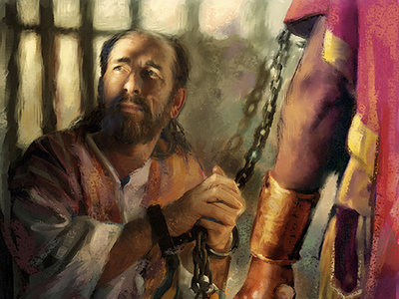
. Date .
246
During Paul's imprisonment in Rome
Fall AD 61
Notes:
He wrote this personal letter from prison in Rome in AD 61.
The names in verse 24 match those in Colossians 4 exactly, indicating that this letter was sent along with Tychicus from Rome to the city of Colossae along with the letter to the Colossian church.

Slide 34
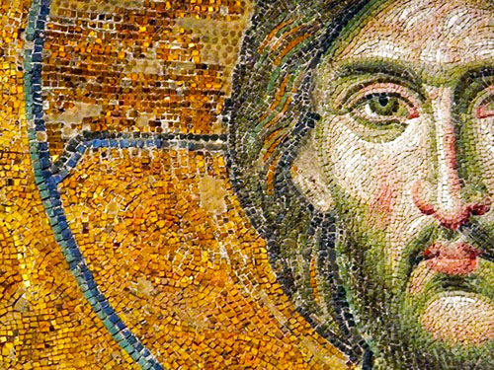
. Recipient .
246
Philemon was a wealthy man in Colosse
Notes:
Paul presents Philemon in a good light with many good virtues (1b-7).

Slide 35
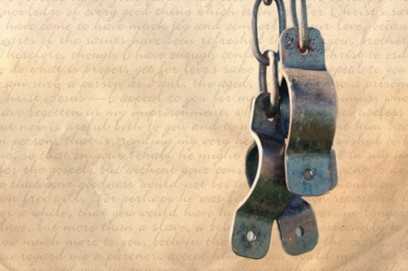
. Recipients .
246
Primary addressee: Philemon
A wealthy Christian slave owner in Colosse
Verse 1b – "To Philemon our dear friend and fellow worker"
Others: Church members
Verse 2 – "to Apphia our sister, to Archippus our fellow soldier and
to the church that meets in your home"
Notes:
He was a Christian who had been involved in ministry with Paul (1b).
He was a wealthy convert of the Apostle Paul (19b), probably during Paul's third missionary journey almost ten years earlier.
The two men didn't necessarily work together in the same city since Paul was in Ephesus while Philemon served in nearby Colossae. Interestingly, Paul had never even been to Colossae.
Apphia (his wife?) is “our sister” and Archippus (his son?) is “our fellows soldier” (2a)—probably a leader in the church, possibly the pastor (Col 4:17).

Slide 36
"May God our Father and the Lord Jesus Christ give you grace and peace"
(v. 3 NLT).
Notes:
Paul wished Philemon God’s grace and peace (3).

Slide 37
"I always thank my God when I pray for you, Philemon, ⁵because I keep hearing about your faith in the Lord Jesus and your love for all of God's people"
(vv. 4-5 NLT).
Notes:
Paul called Philemon a man of love and faith (5).

Slide 38
"And I am praying that you will put into action the generosity that comes from your faith as you understand and experience all the good things we have in Christ. ⁷Your love has given me much joy and comfort, my brother, for your kindness has often refreshed the hearts of God's people" (vv. 6-7 NLT).
Notes:
Philemon greatly encouraged people's faith in Christ (7).

Slide 39
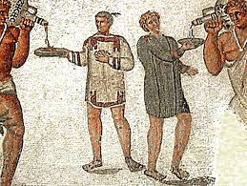
. Occasion .
246
Philemon owned a slave named Onesimus
Notes:
Verses 1-7 have introduced us to two very important people—Paul and Philemon. Now in verses 8-21 we'll see the third important character in the story, the runaway slave, Onesimus. At this point the story really gets interesting because…

Slide 40
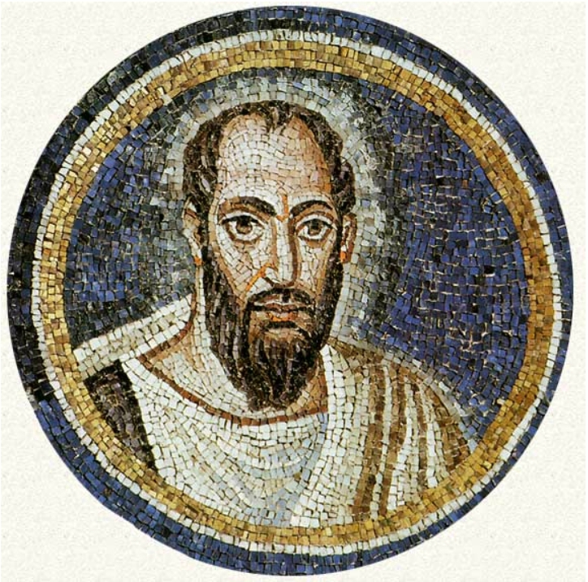
II. Paul appealed for Philemon's forgiveness of his returning runaway slave, Onesimus
(8-21).
Notes:
Paul handles this situation very delicately, not ever even using the word “forgive,” or commanding it, but he does address the need for reconcilation fairly directly.

Slide 41
"That is why I am boldly asking a favor of you. I could demand it in the name of Christ because it is the right thing for you to do. ⁹But because of our love, I prefer simply to ask you. Consider this as a request from me—Paul, an old man and now also a prisoner for the sake of Christ Jesus"
(vv. 8-9 NLT).

Slide 42
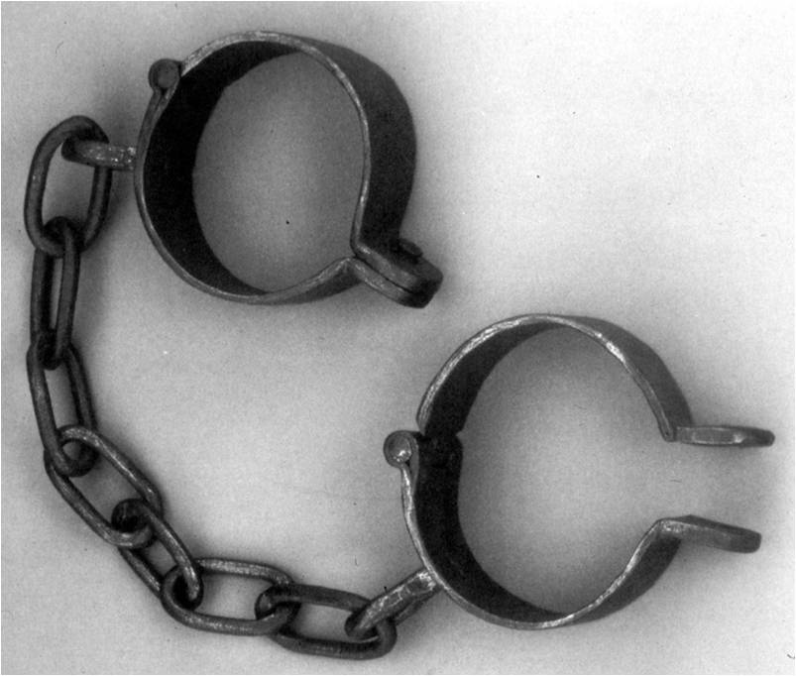
Onesimus ran away
Notes:
Onesimus was Philemon's slave that ran away from his master in Colossae to Rome.

Slide 43
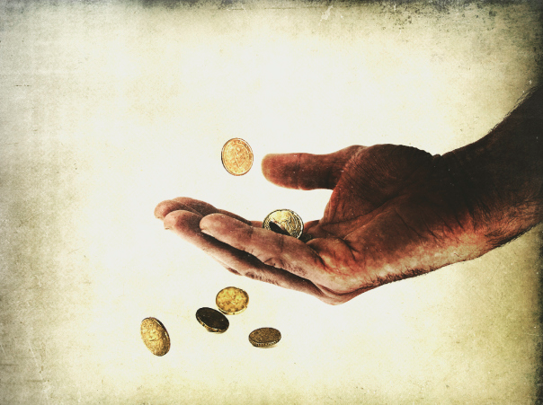
Onesimus had done injustice to and stolen from Philemon
Notes:
He had wronged his master Philemon, possibly robbed him (18).
He then ran away to avoid punishment (15).

Slide 44
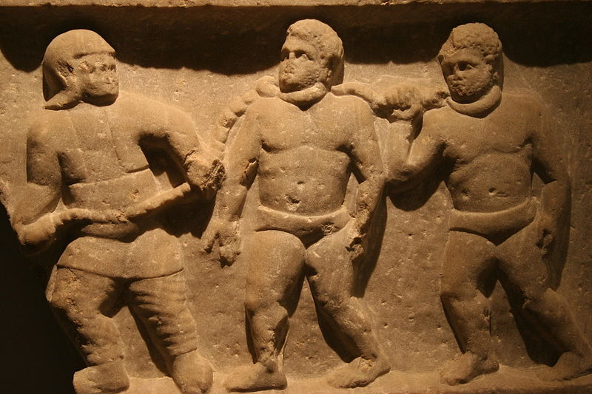
Slavery in the Roman Empire
Notes:
Slaves were considered property in the Roman world and had no rights.

Slide 45
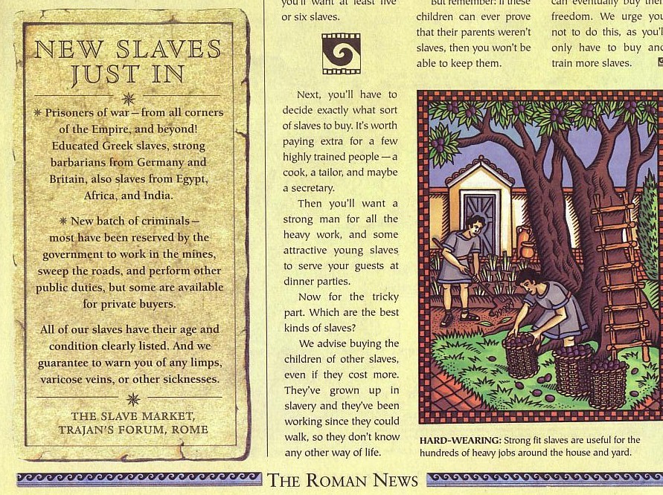
Social Classes
New Slaves Just In
Equestrians (Patricians)
Plebians
Freedman
Slaves

Slide 46
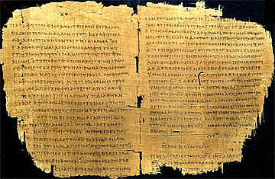
Slavery in the Roman Empire
246
"The slave was absolutely at his master's disposal; for the smallest offence he might be scourged, mutilated, crucified, [or] thrown to the wild beasts"
(J. B. Lightfoot,
Saint Paul's Epistles to the
Colossians and to Philemon, 321)

Slide 47

Roman Empire Populations
Half of the 55 million total were slaves!
Millions of People
Notes:
The Empire had 55 million people:
4 million were citizens (=7%)
55 million were non-citizens (=93%)
27.5 million were slaves (=50%)

Slide 48
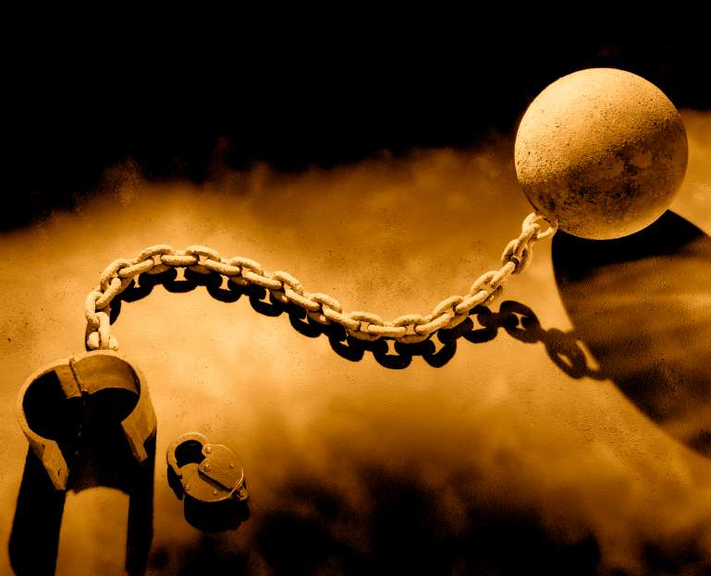
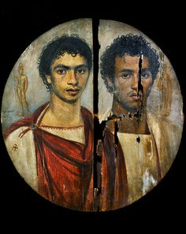
. Rome .
246
Onesimus made his way to Rome, where Paul led this fugitive slave to Christ
"my child whom I have begotten in my imprisonment" (v. 10)
Notes:
At Rome Paul met Onesimus by God's design and led him to faith in Christ.
This is why Paul referred to him as his "my child whom I have begotten in my imprisonment" (10).

Slide 49
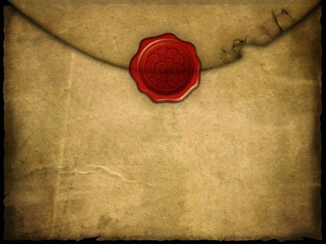
. Occasion .
246
P
Philemon
Paul convinced Onesimus to return to his master, Philemon, even writing the letter that Onesimus himself would carry.
Notes:
Notice that Onesimus' name is mentioned here in verse 10 for the first time when Paul is almost halfway through the letter! He's using a little tact here by having prepared Philemon in the preceding comments before he mentions the name of his unfaithful servant. In the Greek "Onesimus" is the last word in the sentence.

Slide 50
"I appeal to you to show kindness to my child, Onesimus. I became his father in the faith while here in prison. ¹¹Onesimus hasn't been of much use to you in the past, but now he is very useful to both of us.
¹²I am sending him back to you, and with him comes my own heart"
(vv. 10-12 NLT).
Notes:
Onesimus served Paul effectively and they became good friends.
The name "Onesimus" means "useful," and perhaps caused Philemon to say, "Sure, some useful worker he is! The guy takes my money and splits!”
2. Paul uses a clever play on words here by saying that although he was formerly useless, he now is living up to his name (11).
3. I have a feeling that Philemon had only seen Tychicus up to this point in the letter. Then, just when Tychicus reads the word “Onesimus,” Onesiumus made his appearance from around the corner!
• Paul desired to keep Onesimus but knew that restitution was the right thing to do (12).
Retaining a slave could legally be done only with the owner's consent.

Slide 51
"I wanted to keep him here with me while I am in these chains for preaching the Good News, and he would have helped me on your behalf.
¹⁴But I didn't want to do anything without your consent. I wanted you to help because you were willing, not because you were forced” (vv. 13-14 NLT).
Notes:
Paul probably could have convinced Philemon into keeping Onesimus in Rome but didn't want to take advantage of their friendship.
When Tychicus was dispatched to Colossae with the epistle to the church, Paul felt that this was time for Onesimus to return to his master to make things right.

Slide 52
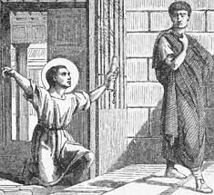
. The Reunion .
246
One wonders what Philemon thought when he saw Onesimus once again
Notes:
Paul wrote the epistle to Philemon explaining the situation and urging Philemon to take Onesimus back as a brother in Christ.

Slide 53
"It seems you lost Onesimus for a little while so that you could have him back forever. ¹⁶He is no longer like a slave to you. He is more than a slave, for he is a beloved brother, especially to me. Now he will mean much more to you, both as a man and as a brother in the Lord"
(vv. 15-16 NLT).
Notes:
Paul urged the wealthy man to begin a new kind of relationship with Onesimus (15-16). (This doesn't necessarily mean to grant him his freedom, but only to treat him with Christian love as an equal brother in Christ so that all three men were on the same level.)

Slide 54
. Repentance .
246
Paul sought to convince Philemon to forgive Onesimus
I am sorry, Master…
Notes:
Paul asked that Philemon accept Onesimus back without any debts (17-19a).

Slide 55
"So if you consider me your partner, welcome him as you would welcome me. ¹⁸If he has wronged you in any way or owes you anything, charge it to me"
(v. 18 NLT).
Notes:
Here we see a picture of God's love for the world by offering to pay the debt Himself! Paul says, "Charge it to my account" just like Christ in essence, said on the cross, "Father, forgive their sins by accepting me as their sacrifice."

Slide 56
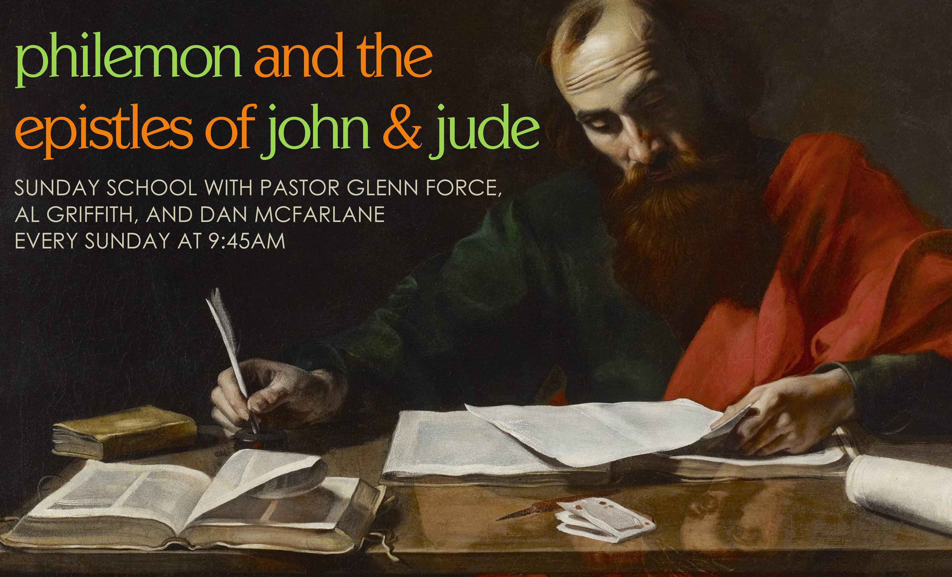
"I, Paul, write this with my own hand: I will repay it. And I won't mention that you owe me your very soul!” (v. 19 NLT).
Notes:
Paul reminds Philemon that he was responsible for his salvation (19b).
(Now that we're introduced to the key people and the basic idea of the book of Philemon, let's take a closer look at some principles about forgiveness found in the book. I've discovered four key truths from the book that will help us know the real character of true forgiveness…)

Slide 57
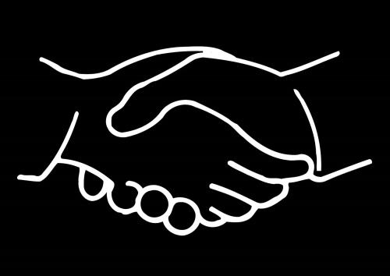
III. Philemon teaches four principles on forgiveness.
Notes:
We can gain four insights about true forgiveness here—what are its traits?

Slide 58

A. True forgiveness is granted freely, not under compulsion (14).

Slide 59
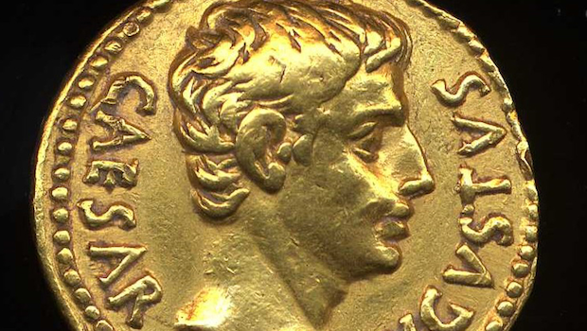
"But I didn't want to do anything without your consent. I wanted you to help because you were willing, not because you were forced" (v. 14 NLT).
Notes:
If Philemon responded out of obligation it would be good, but
if Philemon responded out of free will it would be best.

Slide 60
. Forgiveness.
246
Clearest example of the need to
demonstrate forgiveness in
New Testament
Notes:
How freely has God forgiven us? Totally! And He wants us to imitate His example! Her is the clearest example of the need to show forgiveness in the NT.

Slide 61
If you sinned 3 times a day…
= 1000 sins each year
X 40 number of years
= 40,000 sins so far!
Notes:
Consider how freely God has forgiven us: If you sin only 3 times a day (which is a standard few would ever claim!)
• that's over 1,000 sins each year!
• Multiply that times the number of years you've been sinning.
• For me that's over 40,000 sins that God has freely forgiven me! How could I do any less than freely forgive anyone else?

Slide 62
B. True forgiveness is the natural demonstration of our partnership in the gospel (17).
245
Verses 17-18
"So if you consider me a partner, welcome him as you would welcome me. If he has done you any wrong or owes you anything, charge it to me."
KEY VERSE
Notes:
Refusal to forgive in the church affects more than just the immediate people involved. It spreads to others as well. Forgiveness isn't an individual issue. It's a church issue since we're all partners in Christ.

Slide 63
"This letter is from Paul…
I am writing to Philemon, our beloved co-worker, ²and to our sister Apphia, and to our fellow soldier Archippus, and to the church that meets in your house"
(vv. 1-2 NLT).
Notes:
Refusal to forgive in the church affects more than just the immediate people involved. It spreads to others as well. Forgiveness isn't an individual issue. It's a church issue since we're all partners in Christ.

Slide 64
"One more thing—please prepare a guest room for me, for I am hoping that God will answer your (plural) prayers and let me return to you (plural) soon"
(v. 22 NLT).
Notes:
Verse 22 has the word "your" in the plural, showing this letter would be read publicly.

Slide 65
"May the grace of the Lord Jesus Christ be with your (plural) spirit" (v. 25 NLT).
Notes:
Verse 25 also has the word "your" in the plural, further emphasizing how forgiveness was a church-wide issue.

Slide 66
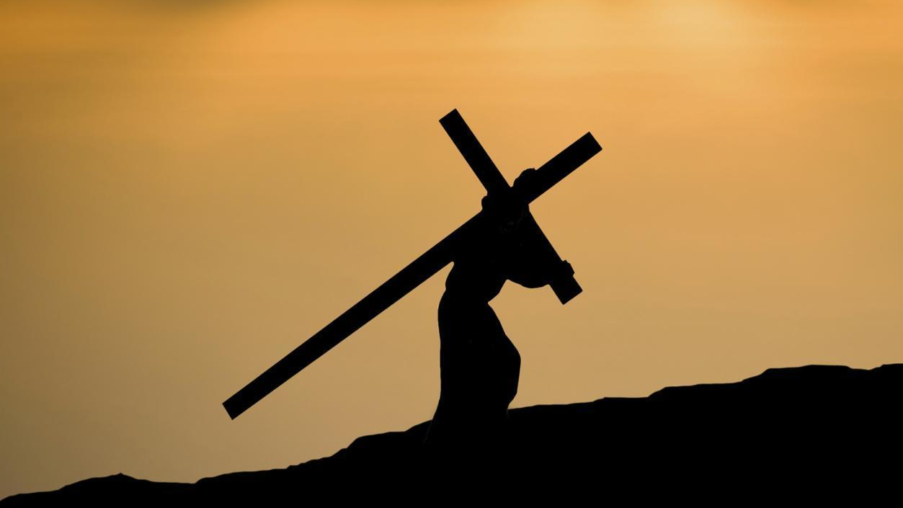
C. True forgiveness is unconditional without putting requirements on the other person (18-19).
246
Illustrates imputation:
Paul requests that all of Onesimus' sin be placed
upon himself.
Verse 18:
"If he has done you any wrong or owes you anything, charge it to me."
Notes:
Paul says to charge the debts of Onesimus to him! Just forgive—with no strings attached—like God does for us. Conditional “forgiveness” is not true forgiveness.

Slide 67
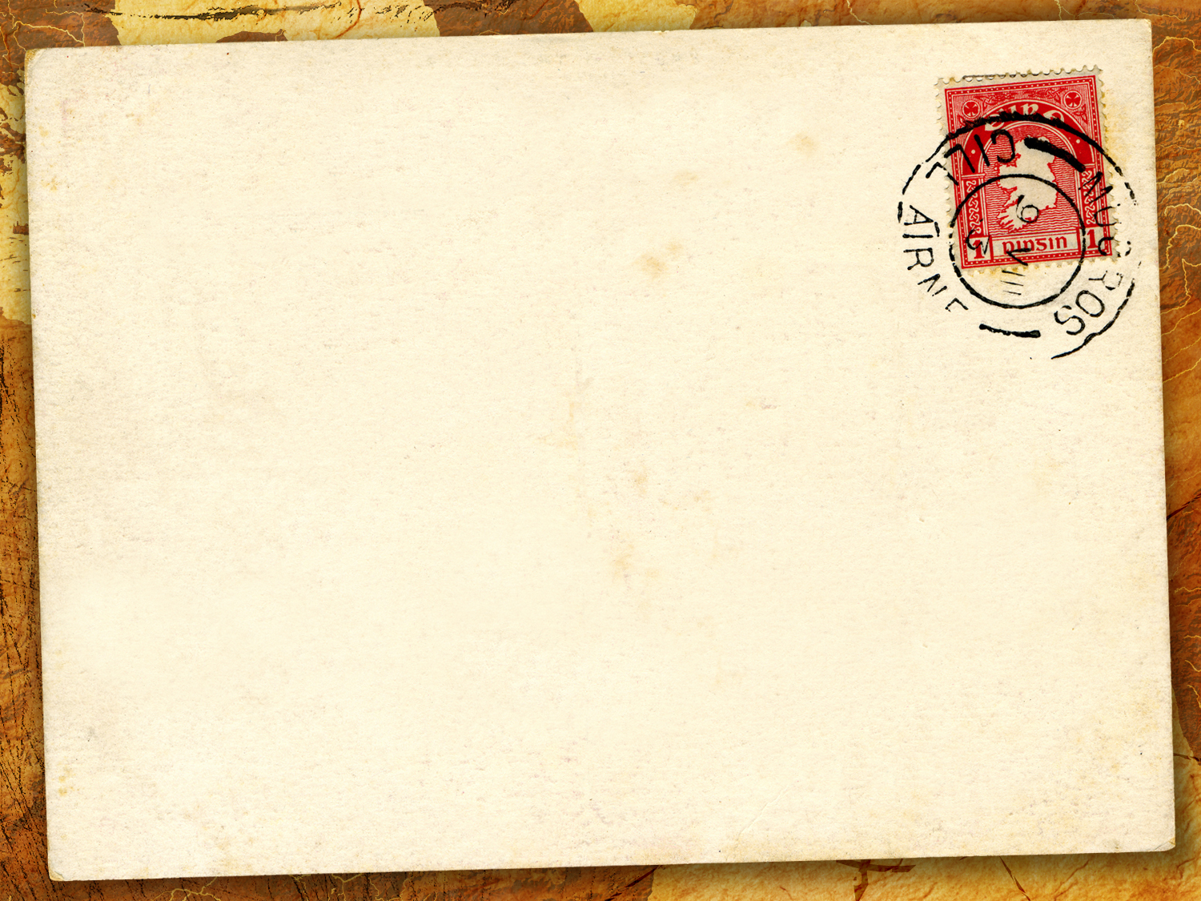
Conditional Forgiveness:
a. "I'll forgive you if…"
"I'll forgive—but I'll never forget…"
c. "I forgive you but don't expect me to change my attitude."
Notes:
How do you know when forgiveness is not unconditional? When you say…

Slide 68
"Forgiveness is… surrendering my right to hurt you for hurting me"
—psychologist Archibald Hunt

Slide 69
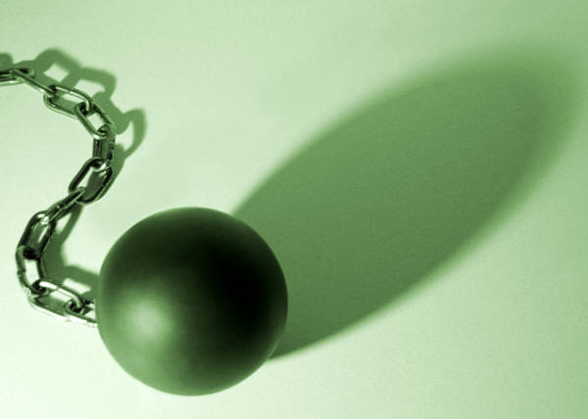
D. True forgiveness "goes the second mile" (21).

Slide 70
"Yes, my brother, please do me this favor for the Lord's sake. Give me this encouragement in Christ. ²¹I am confident as I write this letter that you will do what I ask and even more!"
(vv. 20-21 NLT).
Notes:
Paul may have had in mind here that Onesimus should be returned to Paul or be granted his freedom, perhaps indicated in verse 16 where Paul encourages Philemon to take him back "no longer as a slave."

Slide 71
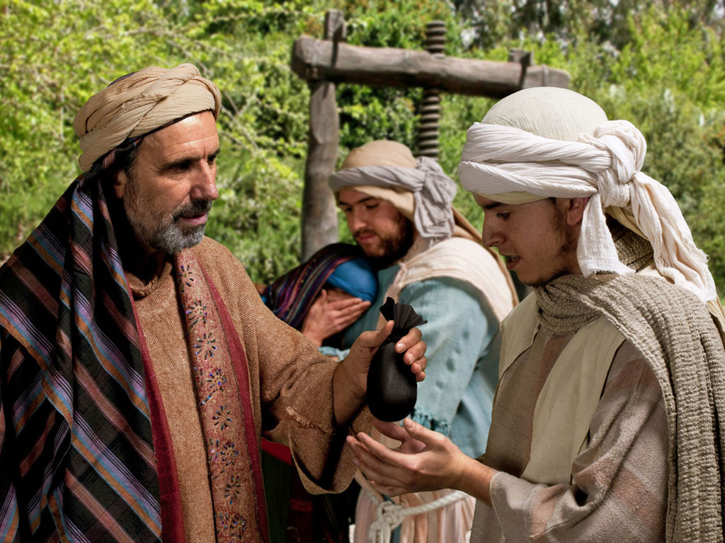
Notes:
The father of the prodigal son was deeply hurt…

Slide 72
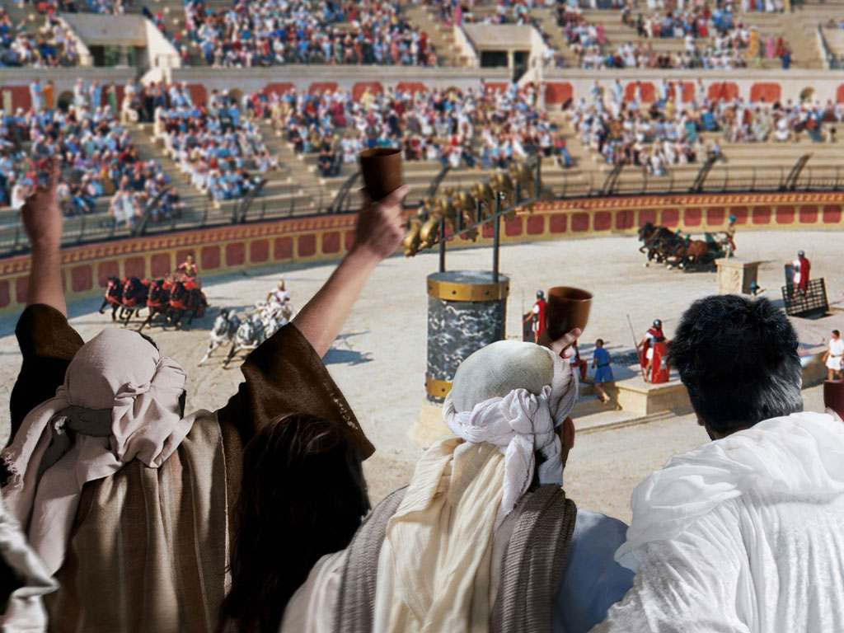
Notes:
…over his son squandering his wealth.

Slide 73
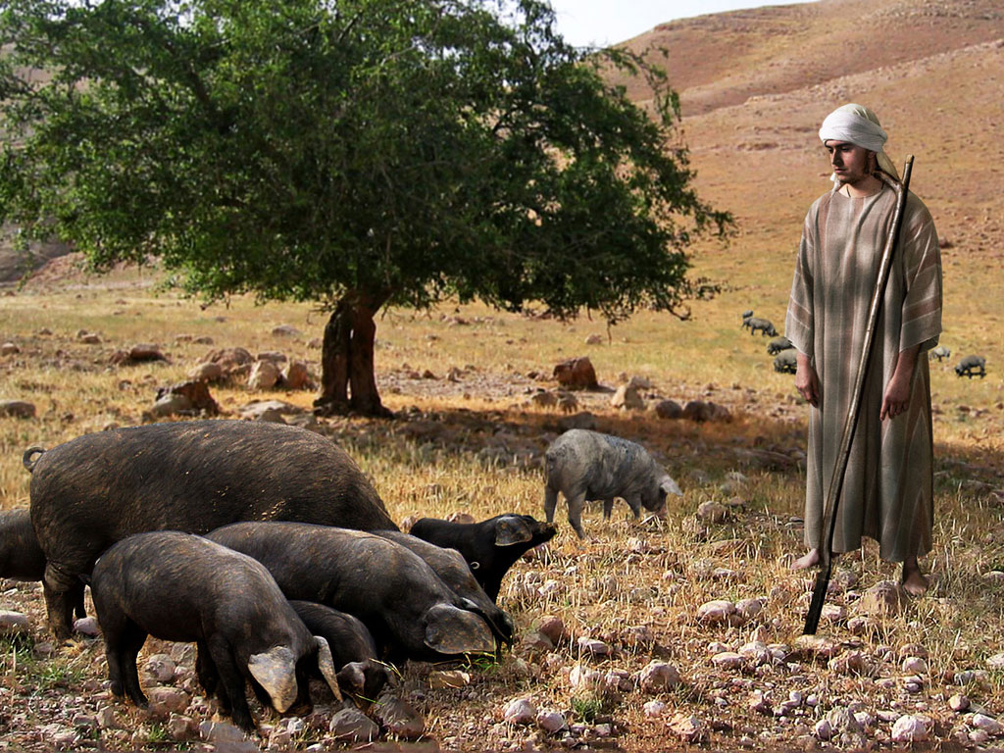
Notes:
Yet, when the son got to his lowest point and then…

Slide 74
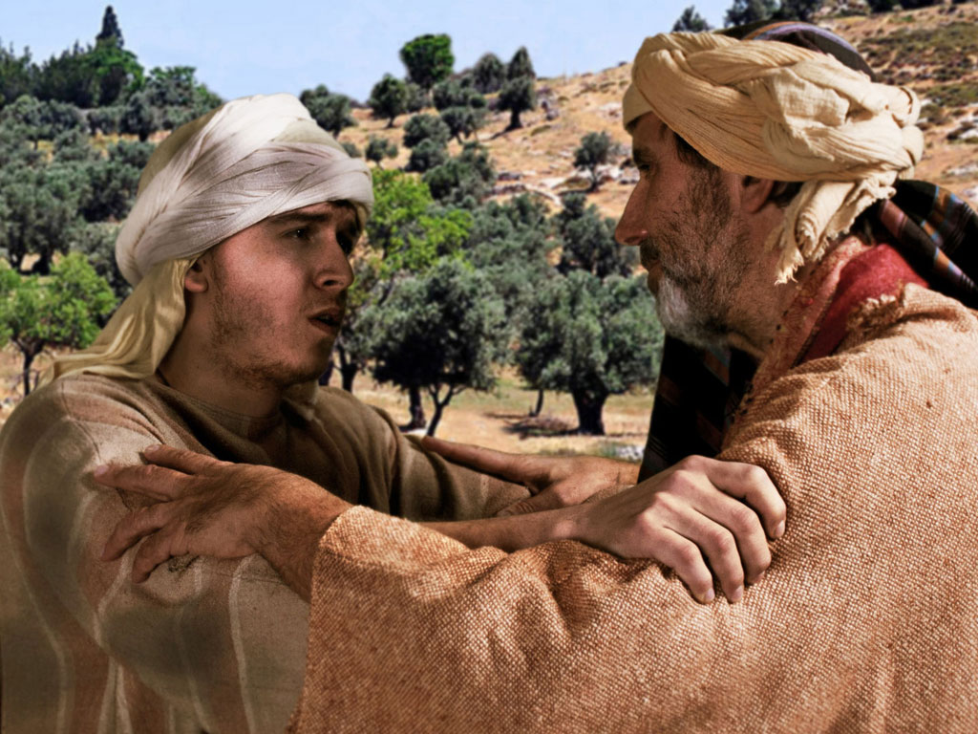
Notes:
…returned home to ask forgiveness, the father not only forgave him for his foolishness…

Slide 75
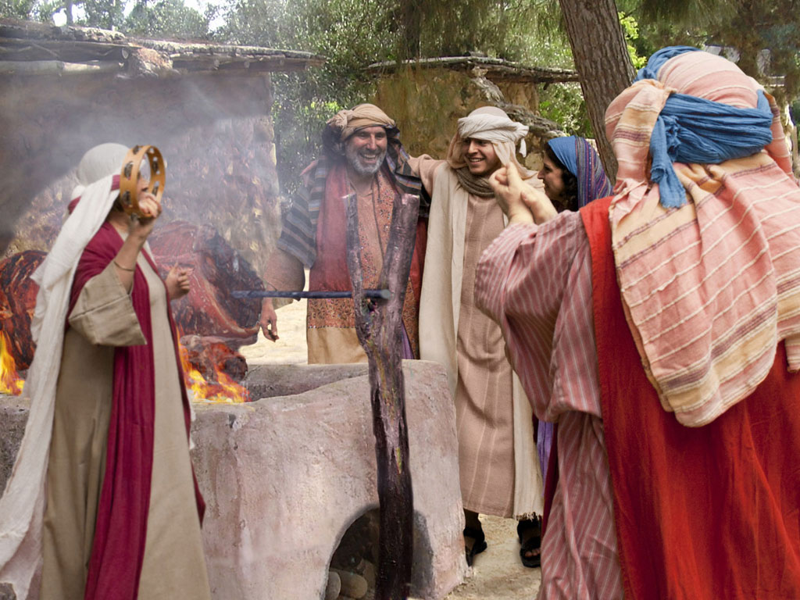
Notes:
but the father welcomed him home, threw a feast, put the ring on his hand and celebrated!
Maybe you need to go the second mile by inviting that person you've forgiven over for dinner, praising that person before others or manifesting that "second mile spirit" in another creative way.

Slide 76


Slide 77
How to forgive those who offend us…
Notes:
We began by asking the question, “How can we forgive those who offend us?” The key is really in verse 17 in the example of Christ taking our sins on himself. This means…

Slide 78
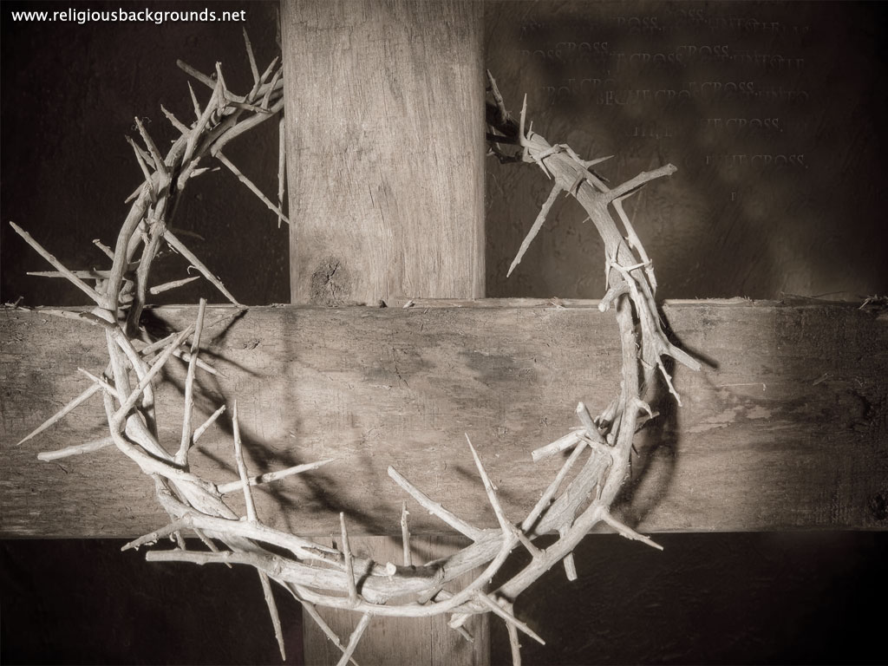
Main Idea
We can forgive others when we see how God has forgiven us.
Notes:
It was clearly God's will that Philemon forgive his repentant, runaway slave who had become a brother in Christ. Why? God forgave Philemon of even a greater debt.

Slide 79
What ever happened to Onesimus?
246

Slide 80
Did Philemon Forgive Onesimus?
247
1. Philemon preserved this epistle & allowed it to be circulated & copied—this would be highly unlikely if he didn’t forgive Onesimus!
2. Paul expressed great confidence that Philemon would do more than even forgive Onesimus (v. 21)—perhaps free him?
3. Ignatius addressed the bishop in the nearby church in Ephesus about AD 115—and his name was Onesimus!
Notes:
Scripture is silent here, but
Since Philemon preserved this epistle and it was included within the New Testament it's reasonable to assume that the letter accomplished its purpose. Philemon did forgive Onesimus and accept him back.
Paul expressed confidence that Philemon would do even more than he asked (v. 21)—perhaps even free Onesimus?
3. Tradition holds that Philemon welcomed Onesimus home, but then sent him back to serve Paul. And get this—over 50 years later the church father Ignatius records that a man named Onesimus was the first Bishop of the church at nearby Ephesus!

Slide 81
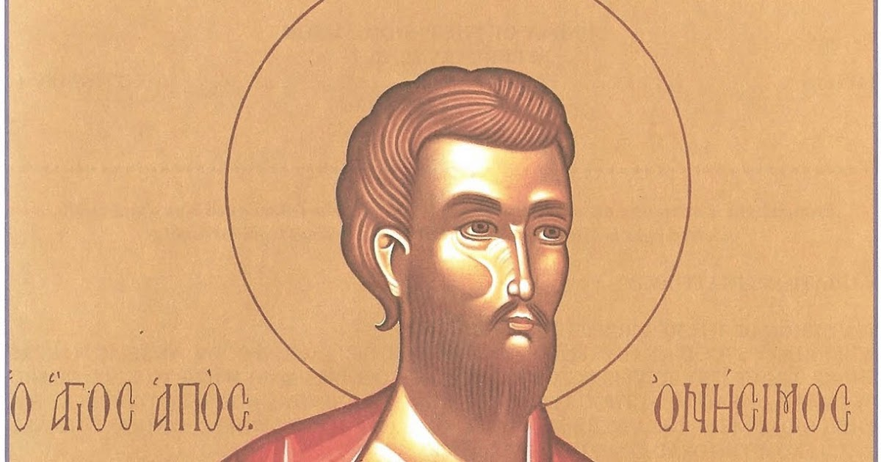
Bishop Onesimus (AD 115)
Notes:
Ephesus was the city which probably was the first place to collect the books of our New Testament! Who knows what God may do in our situations if we, too, are willing to forgive?

Slide 82
Corrie ten Boom
"Forgiveness is setting the prisoner free, only to find out that the prisoner was me."
Notes:
Well, we left Corrie ten Boom before her former persecutor who was saying, "I know God has forgiven me for the cruel things I did at Ravensbruck…" The question was whether she would forgive him—whether she would shake that outstretched hand. Humanly speaking, she couldn’t do it, but, by faith, she sought to see this guard as God would. Although hand arm started stiff and cold, she felt a warmth starting at her heart, running to her shoulder, and down her arm into her hand—both hands, in fact. She grasped his hand with both hands, smiled, and said, “Yes, I forgive you! I forgive you!” (Tramp for the Lord, 56-57).
• She later defined forgiveness: “Forgiveness is setting the prisoner free, only to find out that the prisoner was me.”

Slide 83
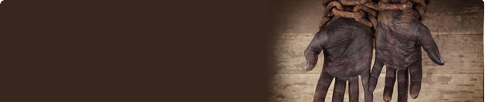
• Application •
245
With whom do you best relate to now?
Philemon
Onesimus
Paul
The Church
Notes:
With which person in this letter do you best relate to now?
Let's humble ourselves before our great God… If Paul were writing a similar letter to you as if you were Philemon, whom would he ask you to forgive?
a) Would he request you to forgive a former friend who hurt you deeply?
b) Would Paul say, "Hey, credit to my account all the money lost in the bad business deal because ___ (you fill in the name) still owes me big bucks?"
c) Would he ask you, plead with you, implore you to forgive your spouse who has really blown it? Or some believers who really did you wrong?
d) Will you, as an act of the will (not the emotions), grant forgiveness unconditionally even if your offender never requests it?
Philemon: Whom do you need to forgive a wrong done to you?
Onesimus: Whose forgiveness do you need to request?
Maybe you're not in the position of Philemon, needing to grant forgiveness, but perhaps you're where Onesimus was, needing to ask forgiveness. Onesimus risked his very life to make things right. Certainly your risk is not greater than his. How will you respond to God's desire for you? Will you take the risk of rejection to restore your walk with God by forgiving your offender?
Paul: How can you help two others reconcile?
The Church: How can you affirm the reconciliation of others?

Slide 84
Black
Notes:
OPTIONAL: Perhaps you wonder what this whole deal about forgiveness is all about. It might be that you have never experienced God's forgiveness of your own sins so this makes it tough to know how to ask or receive forgiveness on a human level. God sent His only Son, Jesus Christ, to pay the penalty you deserved for your sins. He freely offers complete forgiveness to you today, right where you are. His hand is reaching out to you like Corrie ten Boom's guard, only He's not requesting forgiveness. He's offering it, along with a brand new kind of life. I invite you to receive this new life by just silently repeating after me, "Lord, I know I've failed you and need your forgiveness. Thank you for dying for me. I receive your free offer of forgiveness right now.”
"Lord God, oh how we well up with gratitude for your love for us and acceptance of us through Christ. Thank you for pardoning us completely and setting the example of how we should also forgive one another. We want to follow those good impulses you've placed in us to do what's right. Help us to trust in your strength to do what we know we should do. In the cleansing name of Christ, Amen."

Slide 85


NT Preaching link at BibleStudyDownloads.org
Get this presentation and script for free!
Notes:
NT Preaching (np)

